Slide 1
Smart Construction (Research Opportunity)
Computer Science
In Kee Kim and Ramviyas N. Parasuraman

Slide 2
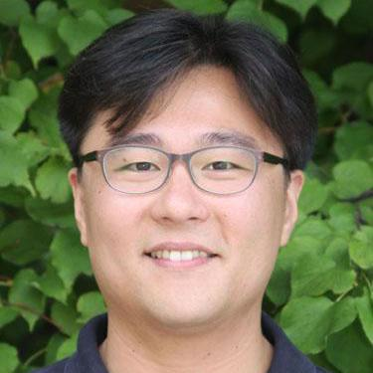
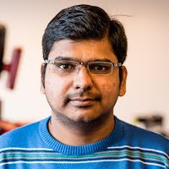
CS Research Team
In Kee Kim
Ramviyas Nattanmai Parasuraman
Assistant Professor in CS at UGA
Ph.D. in Computer Science from UVa
10+ R&D Exp. From IBM, LG, and Ericsson
Research Area
Cloud Computing
Distributed and Computer Systems
IoT and Edge Computing
Data Science Infrastructure
Large-Scale Machine Learning
Assistant Professor in CS at UGA
Postdoc at Purdue U. and KTH (Sweden)
Ph.D. in Robotics and Automation from UPM Spain
Research Area
Robot Sensing and Communication
Network Multi-Robot Systems
Human-Robot Interaction
Intelligent Teleoperation
Search, Rescue, and Field Robotics

Slide 3
Top 4 Research Opportunities
Edge Computing for Uncooperative Environment
Drone as a Computer
DroneSensing: Drone-based Sensing for Soil/Water Quality and Saltmarsh (not limited to)
DroneCharger: Ad-hoc Sensor Battery Recharging by Drone

Slide 4
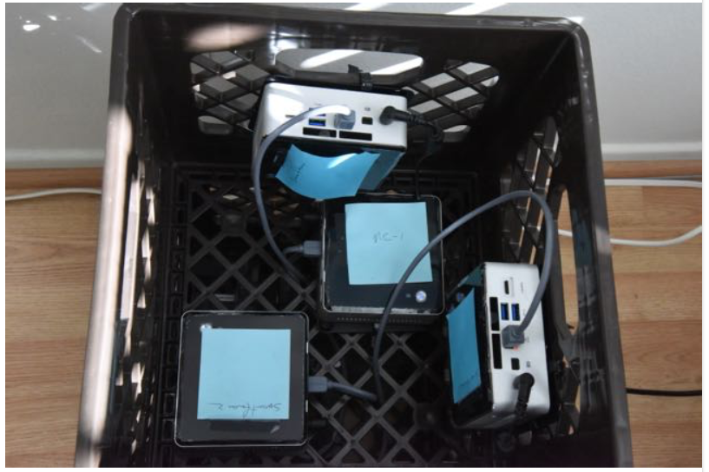
Edge Computing for Uncooperative Environment
Processing Units (Raspberry Pi + WIFI)
Research Challenges:
Mobility (IoT Sensors, Drones)
Limited Battery Power
Limited Computing/Storage Capacity
On-Site/On-Demand Data Processing
Goals
Research on MicroCloud (Edge Computing)
Opportunistic Data Processing Technique
e.g., TensorFlow on Raspberry Pi or De-commissioned Mobile Phones
Opportunistic Sensing and Data Transfer
Whitespace WiFi
Low-Cost Storage (Flash, HDD)

Slide 5
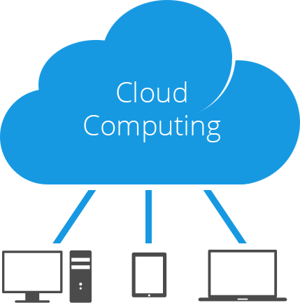
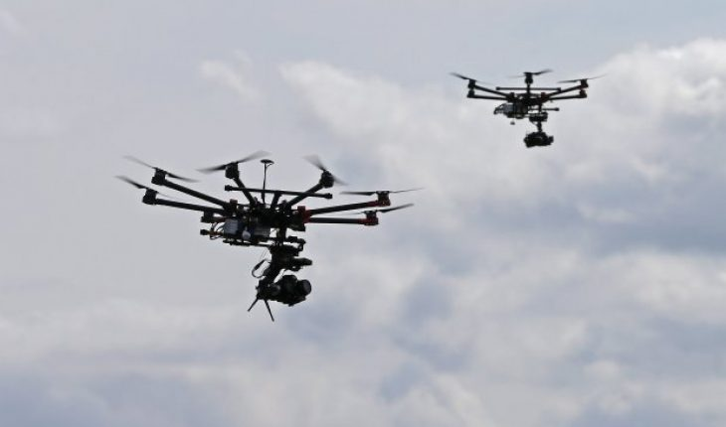
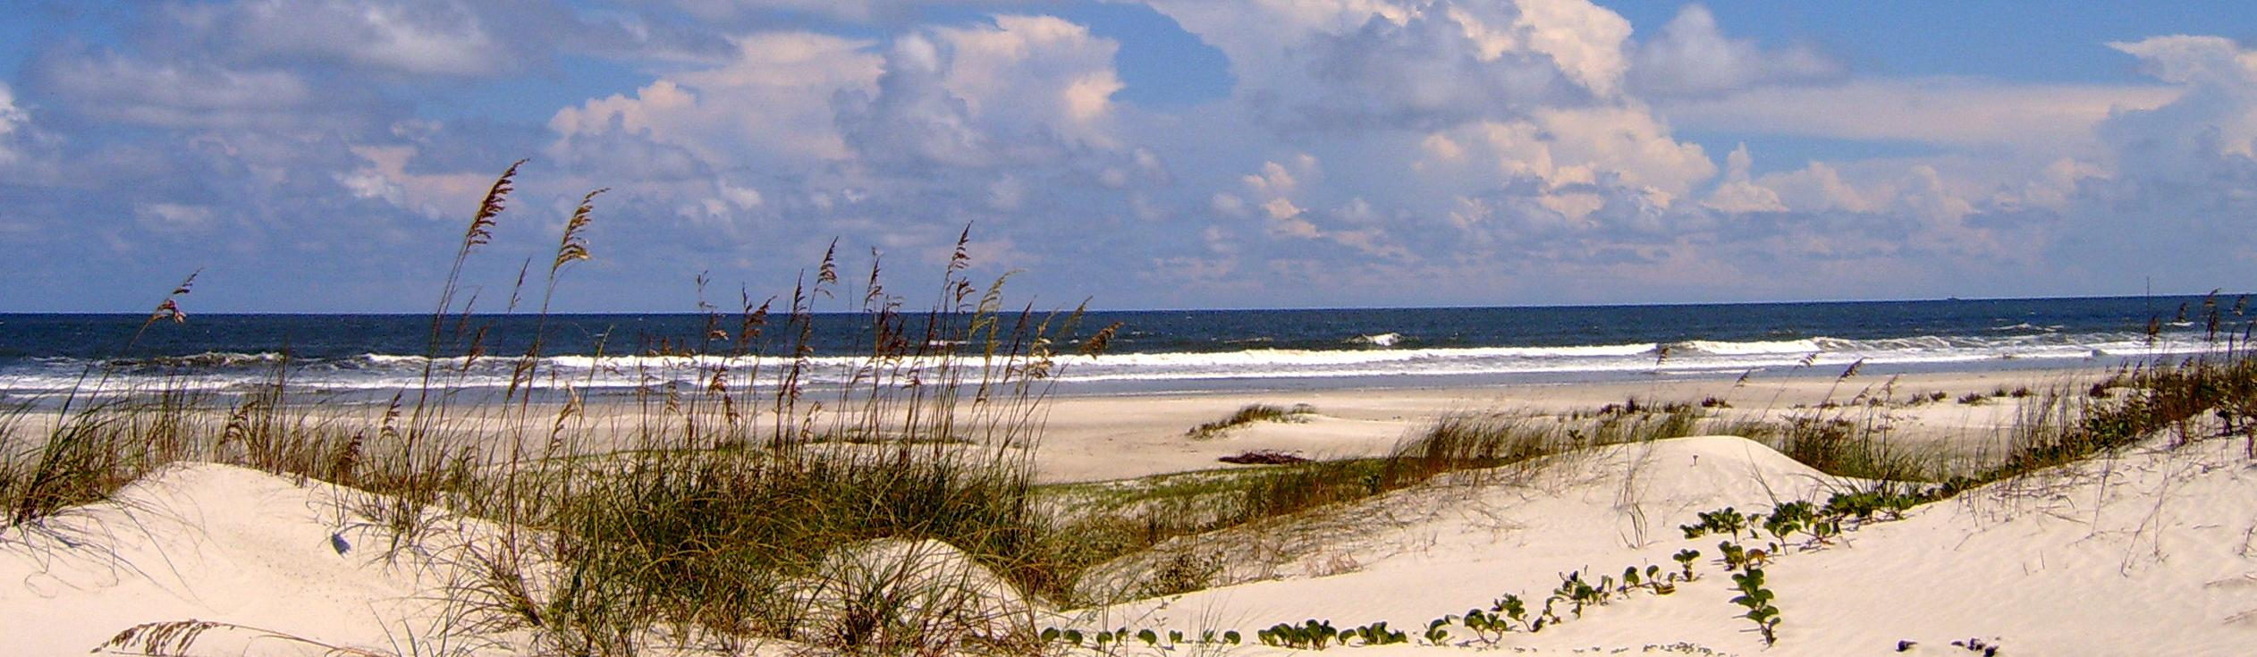
Drone as a Computer (Flying Edge Cluster)
Research Challenges:
Self-Organizing Technique for Drone Platoon
Data Transfer
Within Drones or between Drones and Sensors
Optimal (Energy Efficient) Navigation
to Nearest Stationary Computing Resources
Opportunistic Data Transfer and Computing
Goals
Drone Computing Cluster
Energy Efficient Drone Scheduling and Navigation
Ad-hoc Data Transfer to Drone/Edge
Ad-hoc Flying Data Network
Ad-hoc Computing Cluster
Sensing Data
Sensors

Slide 6
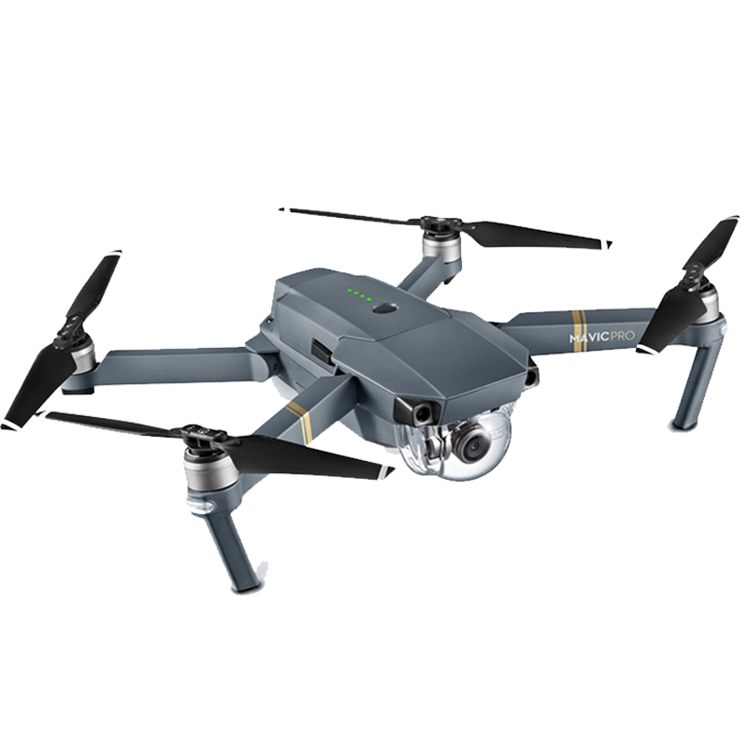
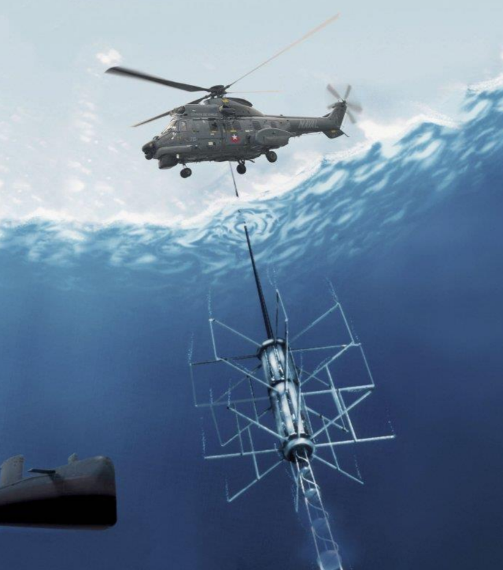
DroneSensing: Ad-hoc Sensing by Drones
Research Challenges:
Drone Dipping Sensor (Soil/Water Quality)
Goals
Creating Drone Dipping Sensor
Automated Processing for Sensing Pipeline
Dipping Sensing
Drone Store/Process Data
Drone Transfer Data to Edge/Cloud
Should be Fully/Semi automated
Drone
Water
Sensor

Slide 7
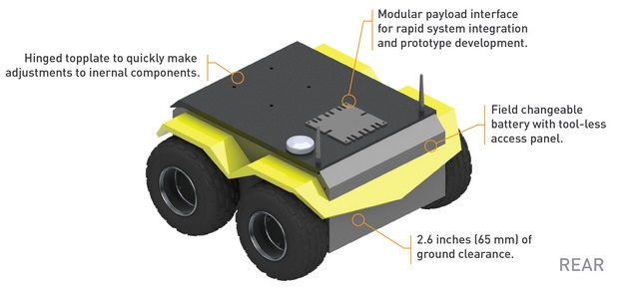
DroneCharger: Ad-hoc Charging by Drones
Research Challenges:
Information – Location, Flight – Sharing between Station and Drones
Autonomous Landing to Mobile Station
Charging Planning (M Stations, N Drones)
Research Goal
Mobile Charging Station for UAVs
Group Charging; M Stations, N Drones
Landed Drone
Mobile Charging Station
(UGV)

